Slide 1
SAP EWM EXTENDED WAREHOUSE MANAGEMENT TRAINING
AnubhavTrainings.com
www.anubhavtrainings.com

Slide 2

SAP EWM TRAINING
BY:-
Mr. Bijoy
www.anubhavtrainings.com
Notes:
https://unsplash.com/photos/uXB-7la5vqA

Slide 3
SAP EWM TRAINING (Day 13)
AnubhavTrainings.com

Slide 4
ST Type controls & Mass upload
Detailed discussion on ST type controls
Understanding of important controls present at ST type level
Testing execution of different criteria's
Testing of Capacity check different options
Mass upload of Bin master, Packspec & Bin sorting

Slide 5
EWM Cross Docking
Contents
Cross-docking is a process, which uses the processing of goods in a warehouse by using incoming stock directly for outbound processing without storing in warehouse.
EWM triggered opportunistic cross-docking is a process that works entirely within a single EWM instance and does not need support from other applications or systems. During creation of warehouse tasks for put away or picking, stock determines from docking areas (staging).
NOTE: It is mandatory to activate the BADI’s to use this functionality.

Slide 6
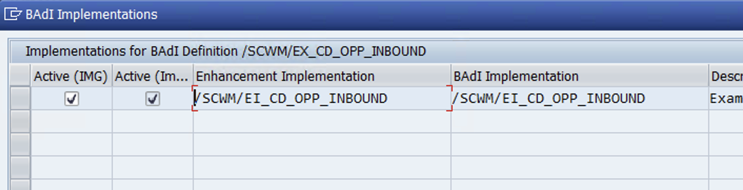
Configuration
BADI: Activation and Adjust Inbound-Triggered Cross docking Process
Spro—SCM EWM—EWM—BADI for EWM—Cross process settings—Cross-docking—Opportunistic Cross docking—EWM-Triggered Cross Docking Inbound—Badi: Activation and Adjustment Inbound-Triggered Cross Docking Process

Slide 7
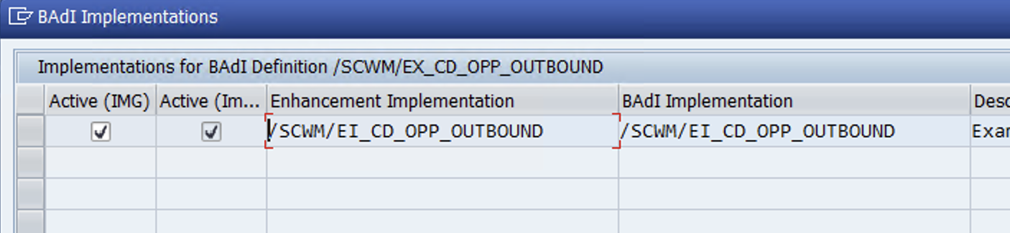
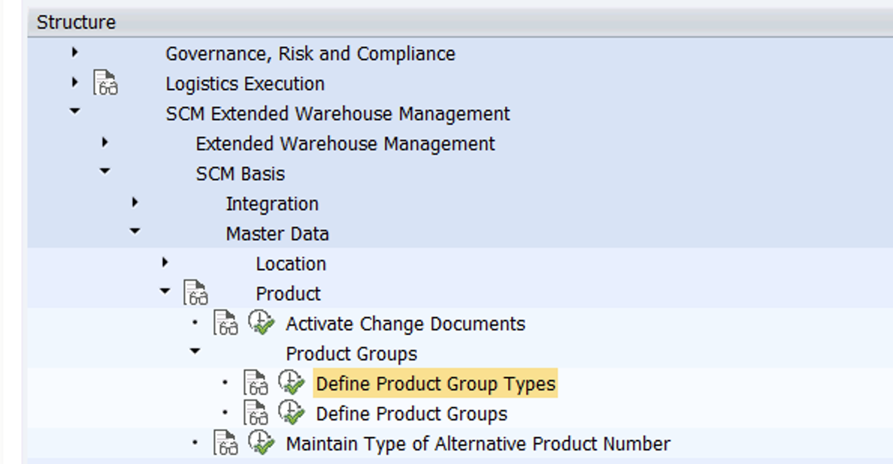
BADI: Activation and Adjust Outbound-Triggered Cross docking Process
NOTE: Product group types and product groups serve to group products of the same kind. You define a product group type for the criterion with which the product groups are to be formed.

Slide 8
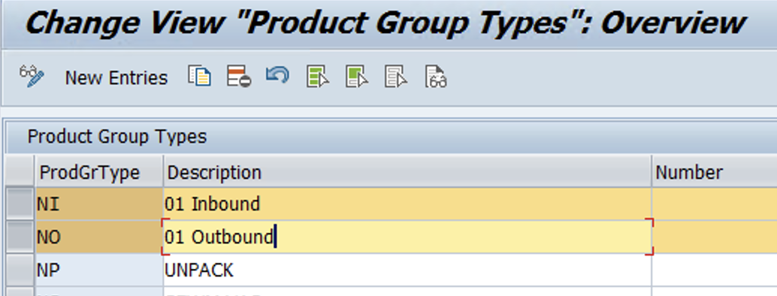
Define Product Group Types

Slide 9
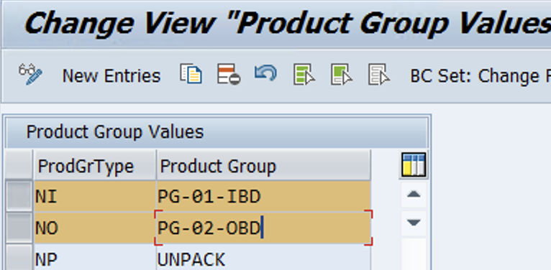
Define Product Group
www.anubhavtrainings.com

Slide 10
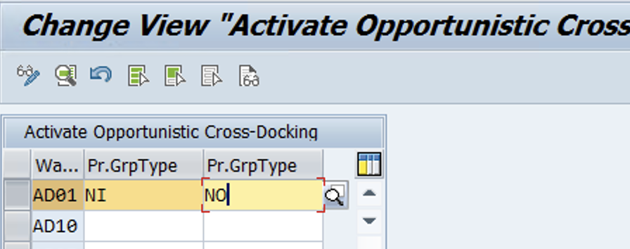
Activate EWM-Triggered opportunistic Cross-Docking
Spro—Img—SCM EWM—EWM—Cross-process settings—Cross-Docking—Opportunistic Cross-docking—EWM triggered opportunistic Cross-Docking—Activate EWM-triggered opportunistic Cross-Docking
www.anubhavtrainings.com

Slide 11
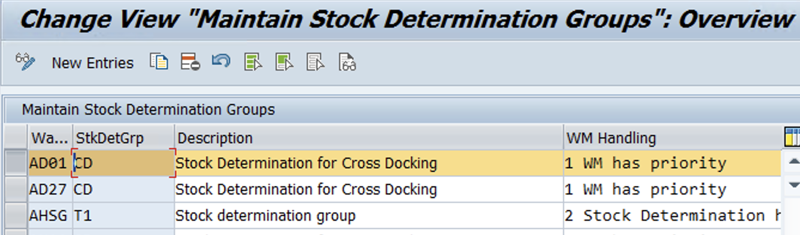
Maintain Stock Determination groups
Spro—Img—SCM EWM—EWM—Cross-process settings—Stock Determination—Maintain Stock Determination groups

Slide 12
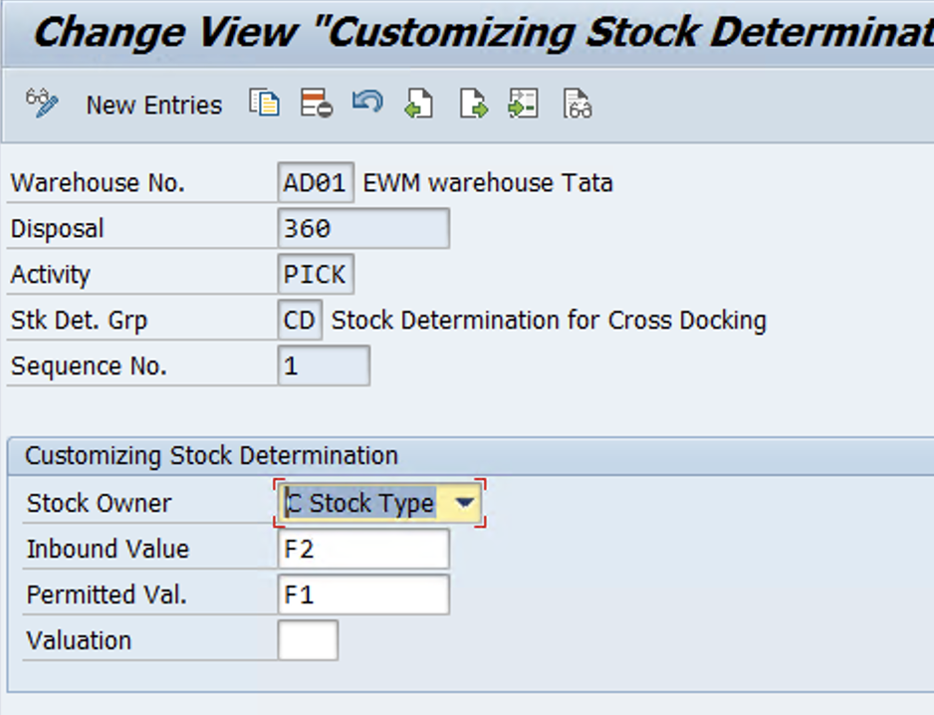
Configure Stock Determination
Same Path as above step)
We need to maintain it because during warehouse task creation with requested stock attributes, the system includes the stocks that possess the permitted attributes in the stock determination.

Slide 13
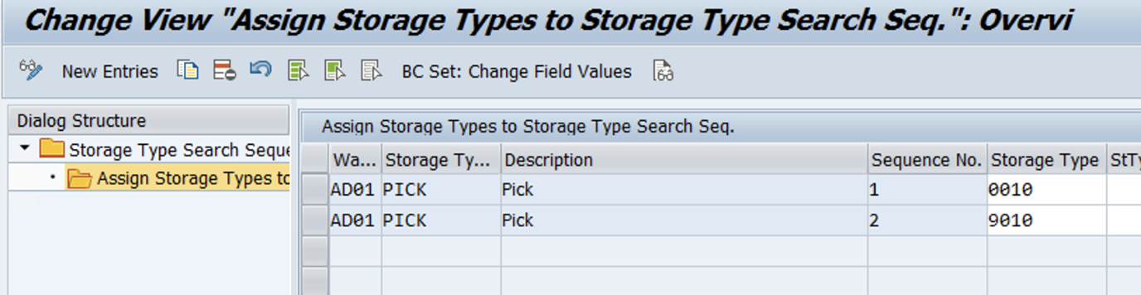
Specify Storage Type Search Sequence
Assign GR staging area in search seq

Slide 14
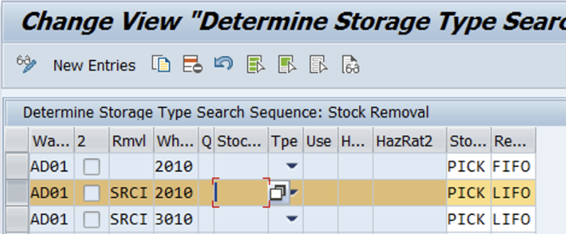
Determine Storage type Search seq
www.anubhavtrainings.com

Slide 15
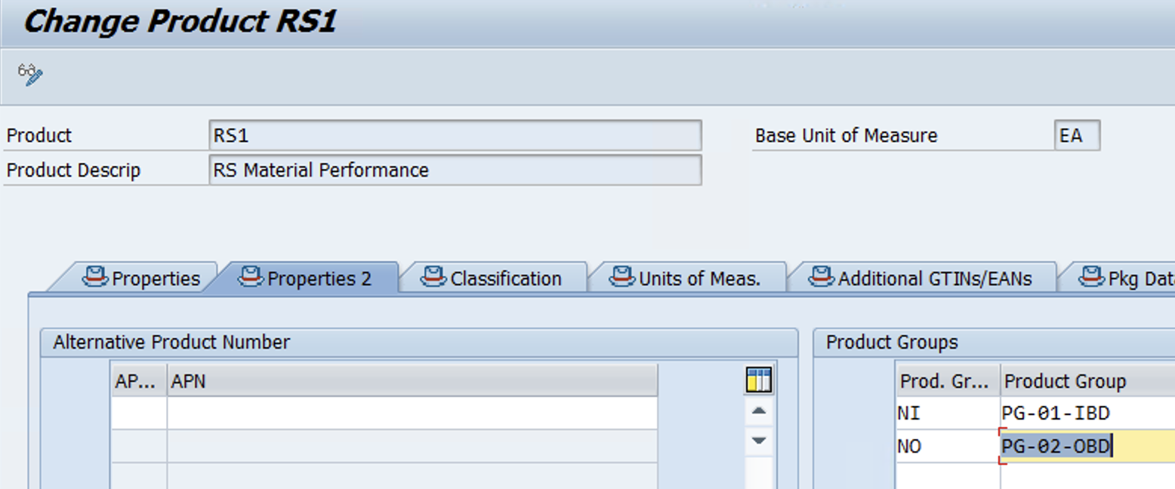
Maintain Product group type and product group:
TRANSACTION: /N/SAPAPO/MAT1
Maintain stock determination group for product under stock removal control area at warehouse level.
TRANSACTION:/N/SCWM/MAT1
www.anubhavtrainings.com

Slide 16
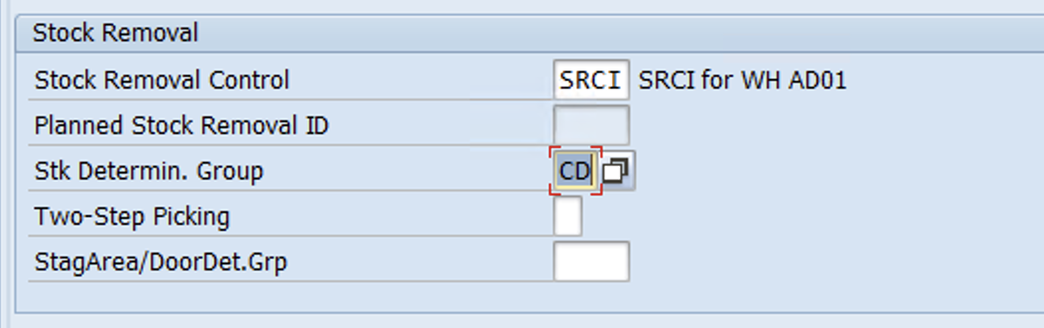
TRANSACTION:/N/SCWM/MAT1
www.Anubhavtrainings.Com

Slide 17
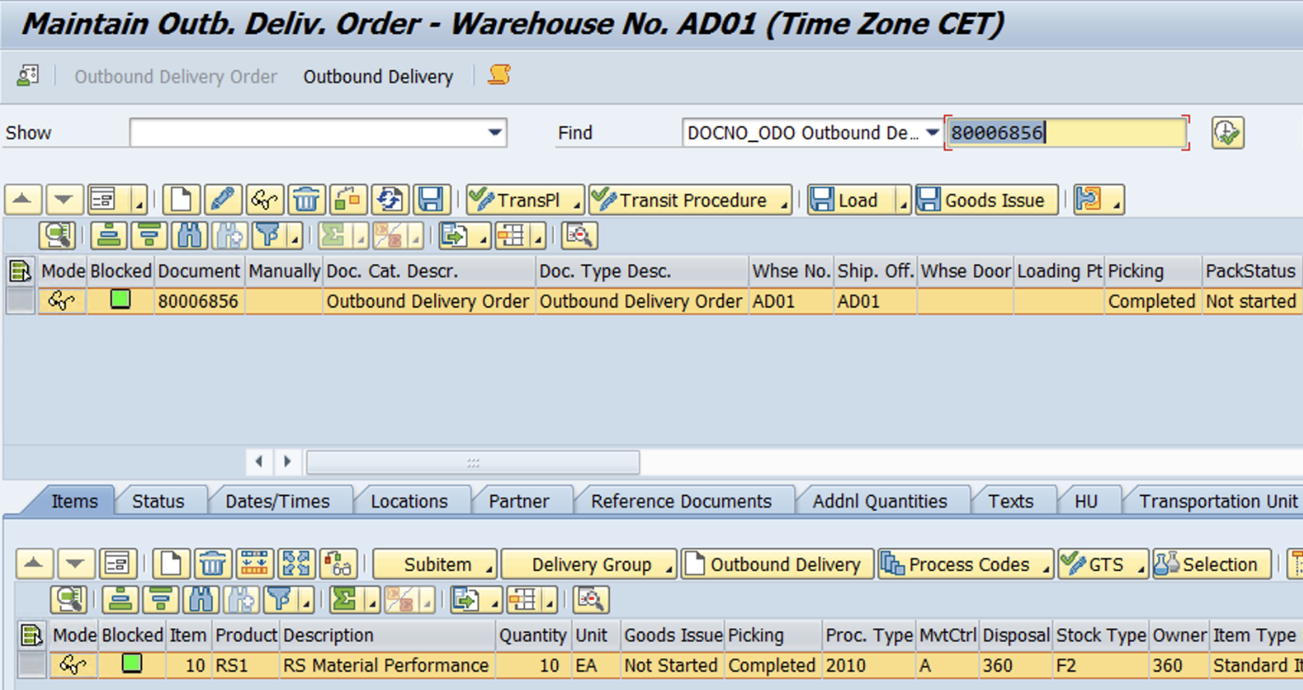
Test Case (Outbound Case)
Before running test case for cross docking, keep ready IBD with GR posted and Check Monitor for 9010 stock
1. Create OBD
www.anubhavtrainings.com

Slide 18
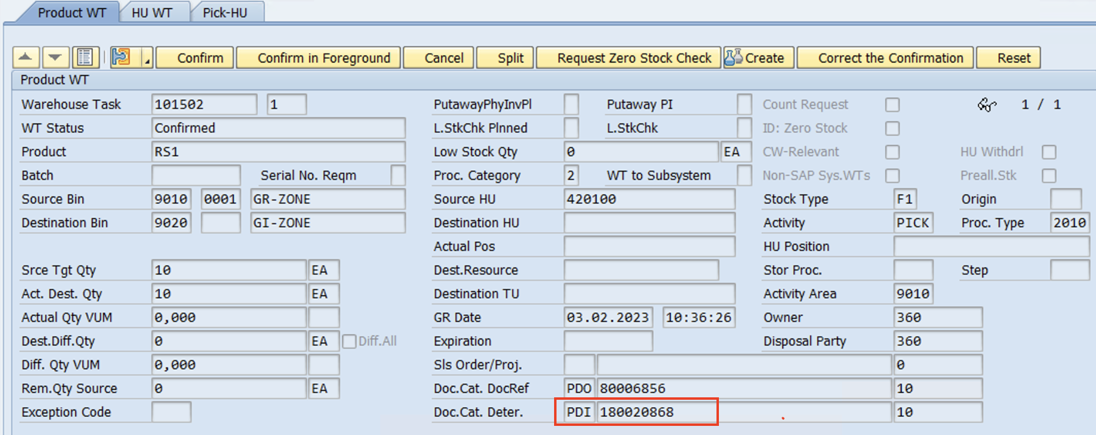
2.Create WT
1. Item has been cross docked - System has picked up the stock from GR staging area! Hence IBD is updated for WT.
www.anubhavtrainings.com

Slide 19
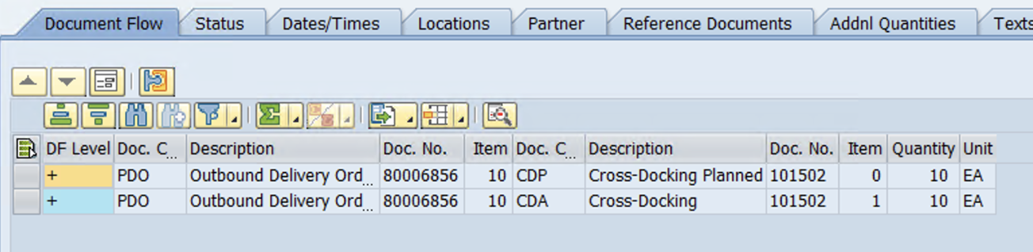
Check OBD document flow (line item details)
www.anubhavtrainings.com

Slide 20
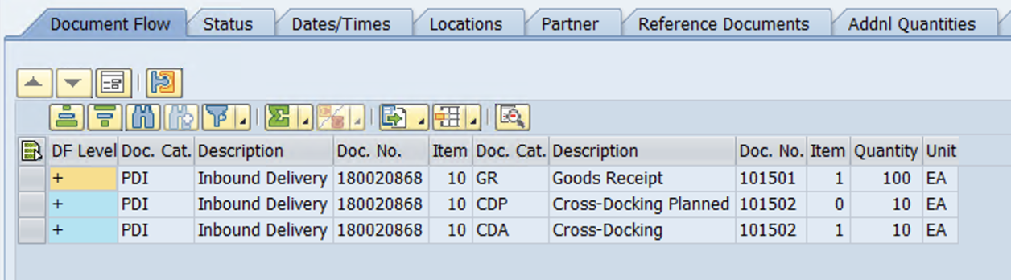
3.Check IBD doc flow
www.anubhavtrainings.com

Slide 21


End of Session 13
www.anubhavtrainings.com

Slide 22

FEEL FREE TO ASK QUESTIONS

Slide 23

Feedback

Slide 24
THANK
YOU

Slide 25




More from AnubhavTrainings.com

Slide 26






We’re committed to empower you to be
#FutureReady
through powerful training solutions.
We build the workforce of the future.
250+
Corporate Clients
30,000+
Learners Trained
25000+
Learners Placed
FREE WEBINARS
Sign up for free webinars with industry experts every fortnight!
Enroll Now!

Slide 27
FREE WEBINARS
Sign up for free webinars with industry experts every fortnight!
Contact us today!
www.anubhavtrainings.com

